Slide 1
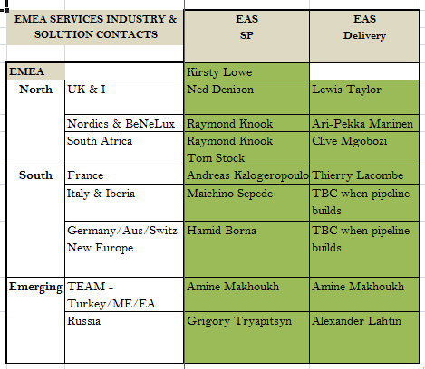
Professional Services EAS leads:

Slide 2
EMEA Presale Organization Skill Matrix
EAS ‘go-to’ SEs 201 & 301 SEs
SE Name | Region | EAS
Garen Yacoubian | UKI | 201
Mostafa Mansour | TEAM | 201
Kirill Kochubey | Rus | 0
Jan Vala | EMEA E. | 101
Steven Etberg | SA | 201
Dmitry Sergeev | Rus | 201
Gianluca d'Amora | Italy | 201
Dietmar Enghauser | Germany | 301
Dominique Gallet | France | 201
Alex Fritel | France | 201
Margo Vrolix | Benelux | 201
SE Name | Region | EAS
Garen Yacoubian | UKI | 201
Jasmit Sagoo | UKI | 201
Tarique Abuelhassan | TEAM | 201
Mostafa Mansour | TEAM | 201
Dieter Hovorka | TEAM | 201
David Gonzales B. | SPT | 301
Alan Hutcheson | SPT | 301
Jordan Guinn | SPT | 201
Dmitry Etin | SPT | 201
Steven Etberg | SA | 201
Dmitry Sergeev | Rus | 201
Ari Mattila | Nordics | 201
Gianluca d'Amora | Italy | 201
Jesus Gonzalez | Iberia | 201
Markus Rogger | Germany | 301
Dietmar Enghauser | Germany | 301
Jan Wunderlich | Germany | 201
Dominique Gallet | France | 201
Stéphane Taribo | France | 201
Alex Fritel | France | 201
Erno Rorive | Benelux | 201
Margo Vrolix | Benelux | 201

